Slide 1
Differences between Qualitative and Qualitative Research in Health
Name
Date

Slide 2

Understanding Research in Healthcare
Contrast in Quantitative and Qualitative Design

Slide 3
Introduction
Quantitative and qualitative research approaches outline different assumptions about the global aspects as well as the way science should be carried out.
The approaches also describe the different solutions to different problems by also providing criteria for carrying out the required processes (Cleland, 2015).
The presentation describes the differences between the two research designs by different aspects such as data analysis, tools applied, and data interpretation.
Quantitative design originally extracts from a positivist paradigm where the final goal of knowledge is giving a description of the various life spectacles that humans experience daily, which are observable and measurable (Cleland, 2015).
In the qualitative approach, the premise is subjectivity. The two approaches are very significant in health care in the assessment and quality improvement.

Slide 4

Healthcare Systems
There are complexities in the health sector, globally.
The researchers, therefore, are required to come up with approaches that embrace various dimensions in solving the health complexities.
The complexities come as a result of the aging population, the prevalence of the chronic disease, and restricted health budgets (Halcomb,& Hickman,2015).
Other common factors include economic, social, cultural, and environmental, which also add more complexity to the healthcare sector.

Slide 5
Hypothesis Testing
In wide scope, the quantitative design of research mostly involves testing of hypothesis and confirmation.
On the other hand, qualitative research is about the generation of hypotheses and trying to understand it.
Additionally, quantitative research seeks to validate a view or an idea and theories by carrying out an experiment and results from analysis (Cleland, 2015).
On the other hand, in qualitative research, the hypothesis application is inductive.
Therefore it this means that explanations are established from the ground on the basis of the discovery from the results.

Slide 6
Explanation of Phenomenon
Qualitative research in healthcare research has been scarcely used for some time, but the approach is now becoming common since it has been embraced in both the cultural and social dimensions (Saunders et al. 2018).
The approach of qualitative research carries out the analysis of a phenomenon through its trends and the frequencies levels.
The approach thrives in describing the phenomenon at hand so as to bring out the meaning.
The differences in the researchers occur mostly in matters of ontology, data collection, and evaluation of the data.

Slide 7
Planning Procedures
Quantitative
Qualitative
The approach involves planning earlier and providing prescriptions.
Before the process of data collection is done, all the relevant aspects are designed first for the easy facilitation of the project.
The details are well elaborated in advance where the design for carrying out the study is established at the beginning of the study (McCusker, & Gunaydin, 2015).
The participants are identified before the process starts, and their location is established first before the study begins.
The research is determined by the question to be addressed in the whole research process. Therefore the research question provides the basis of understanding the whole process.
The scoping of the project is, however, done at the beginning in order to consider what data to use.
The data collection processes, data analysis, and theory modification processes happen simultaneously.
The simultaneous happening influences all the other processes involved.
There may be modified as the process is in progress.

Slide 8
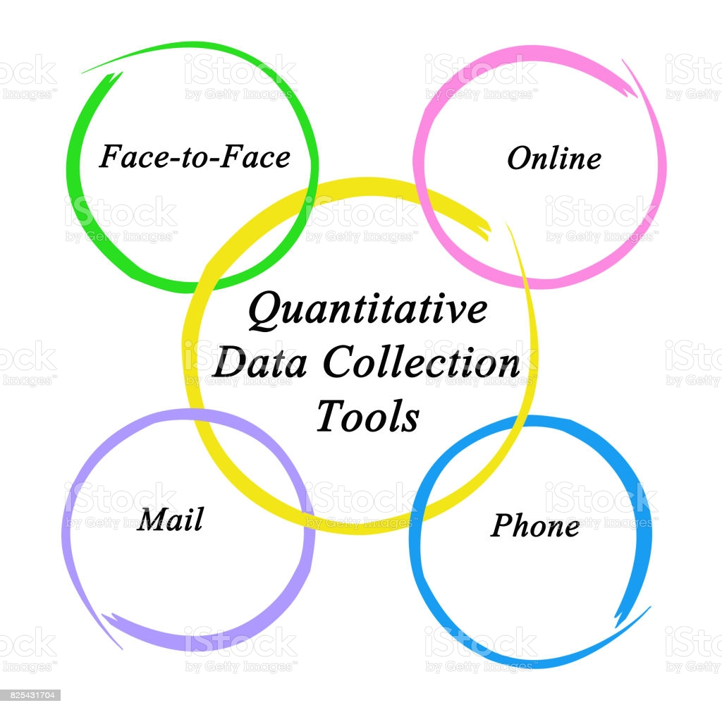
Data Collection in Quantitative Design
The methods of collecting data in the quantitative approach comprise of objective measurements.
The most common methods are structured methods of data collection.
The most common is the use of the survey, structured interviews, carrying out measurements, among others.

Slide 9
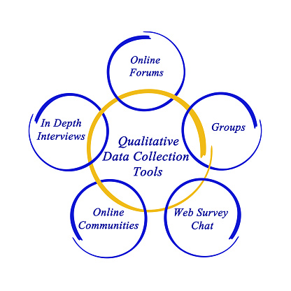
Data collection in Qualitative Design
In the approach, the methods of collecting data are in-depth and wider in scope.
The approach seeks to offer a description of certain themes in order to bring out their understanding.
One on one or online interviews can be organized to groups such as focus groups or one on one group.
The groups formed are dependent on the topic under the study as well as the cultural context in line with the project objectives.

Slide 10

Data Analysis in Qualitative
In healthcare, the commonly applied method of data analysis is QCA.
The method's focus is on knowledge development and the understanding of the study and the phenomenon under research (Assarroudi et al. 2018).
The method involves language application and contextual clues to establish meaning in the process of communication.

Slide 11

Data Analysis in Quantitative Research
The process involves the presentation and interpretation of the data, which is numerical.
It also encompasses statistical analysis, which comprises of inferential and descriptive statistics.
An example is the frequency of male and female respondents out of the total participants.
The data is described in terms of mean, median, or mode.

Slide 12
References
Cleland, J. (2015). Exploring versus measuring: considering the fundamental differences between qualitative and quantitative research. Researching medical education, 1-14.
Halcomb, E. J., & Hickman, L. (2015). Mixed methods research.
Saunders, B., Sim, J., Kingstone, T., Baker, S., Waterfield, J., Bartlam, B., ... & Jinks, C. (2018). Saturation in qualitative research: exploring its conceptualization and operationalization. Quality & quantity, 52(4), 1893-1907.
McCusker, K., & Gunaydin, S. (2015). Research using qualitative, quantitative or mixed methods and choice based on the research. Perfusion, 30(7), 537-542.
Assarroudi, A., Heshmati Nabavi, F., Armat, M. R., Ebadi, A., & Vaismoradi, M. (2018). Directed qualitative content analysis: the description and elaboration of its underpinning methods and data analysis process. Journal of Research in Nursing, 23(1), 42-55.

